Slide 1

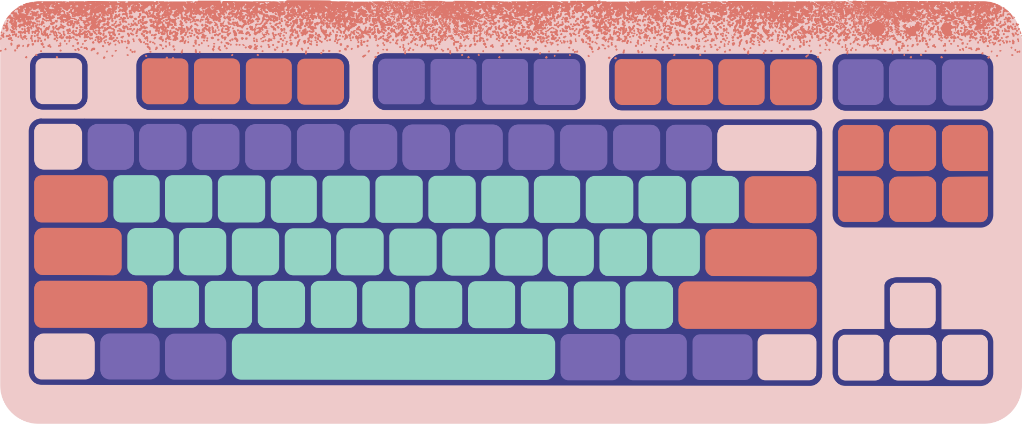










SENTENCE SIMILARITY
NLP PROJECT

Slide 2




Introduction
Natural Language Processing (NLP) is a branch of artificial intelligence concerned with the interaction between computers and humans through natural language. It encompasses a wide range of tasks, from language understanding to language generation, with the goal of enabling computers to understand, interpret, and generate human language in a meaningful way.

Slide 3


Significance of NLP

Slide 4
USAGE
1. Text Classification: Assigning predefined categories or labels to textual data, such as sentiment analysis, spam detection, and topic classification.
2. Named Entity Recognition (NER): Identifying and classifying named entities (e.g., person names, organization names, locations) within text.

Slide 5
USAGE
3. Machine Translation: Translating text from one language to another, often using statistical or neural machine translation models.
4. Information Extraction: Extracting structured information from unstructured text, such as extracting entities, relationships, and events.

Slide 6
USAGE
5. Semantic Understanding: Understanding the meaning and context of text, including tasks like semantic similarity, paraphrase detection, and text summarization.

Slide 7

Sentence similarity

Slide 8
WHat’s sentence similarity
Sentence similarity or semantic textual similarity is a measure of how similar two pieces of text are, or to what degree they express the same meaning

Slide 9
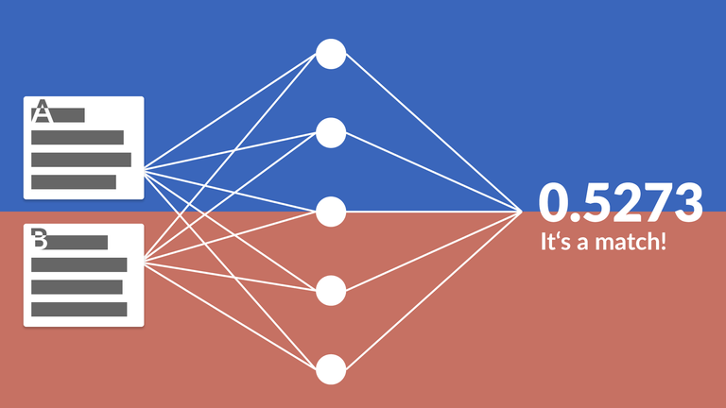
IMPORTANCE OF SENTENCE SIMILARITY

Slide 10
Usage
Information Retrieval: Assessing the similarity between a user query and documents in a database is crucial for retrieving relevant information.
Question Answering: Determining the similarity between a user query and potential answers helps in selecting the most relevant response.

Slide 11
METHODS FOR MEASURING SENTENCE SIMILARITY

Slide 12
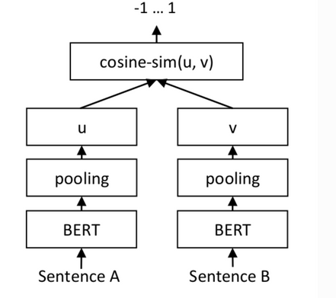
METHODS
1. Cosine Similarity: A mathematical measure that calculates the cosine of the angle between two vectors, representing the sentences in a high-dimensional space. It measures the similarity based on the orientation, regardless of the magnitude of the vectors.

Slide 13
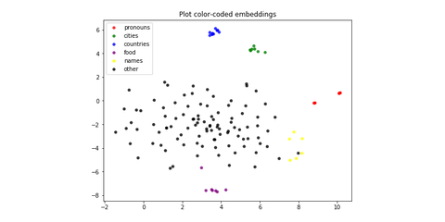
METHODS
2. Word Mover's Distance (WMD): A distance metric that considers the "distance" between two sentences as the minimum amount of "work" required to transform one sentence into another, where "work" is measured as the minimum cumulative distance that words in one sentence need to travel to match the words in the other sentence.

Slide 14
METHODS
3. Siamese Neural Networks:
A type of neural network architecture that learns to encode sentences into fixed-size vectors (embeddings) in such a way that semantically similar sentences are mapped closer together in the embedding space. Siamese networks are trained with pairs of sentences and learn to minimize the distance between similar pairs while maximizing the distance between dissimilar pairs.
Notes:
These methods offer different approaches to measuring sentence similarity, and their suitability depends on the specific task requirements, dataset characteristics, and computational constraints. Ongoing research continues to explore novel techniques for improving the accuracy and efficiency of sentence similarity measurement in NLP applications.

Slide 15
MODELS

Slide 16

WHAT’S THE PURPOSE OF THE MODELS?

Slide 17
The model is designed to determine the semantic similarity between pairs of sentences. It can be used in various natural language processing (NLP) tasks such as duplicate detection, question answering, and information retrieval.

Slide 18

Exploring Sentence Similarity with MiniLM-L6-v2

Slide 19
introduction
Pre-trained transformer models like MiniLM-L6-v2 are utilized for generating these embeddings due to their ability to capture complex linguistic patterns and semantic nuances from large text corpora. Leveraging the knowledge learned by these models empowers us to enhance various NLP tasks, from measuring sentence similarity to sentiment analysis and beyond.
Notes:
These methods offer different approaches to measuring sentence similarity, and their suitability depends on the specific task requirements, dataset characteristics, and computational constraints. Ongoing research continues to explore novel techniques for improving the accuracy and efficiency of sentence similarity measurement in NLP applications.

Slide 20

whats transformers?

Slide 21

Transformer models have revolutionized NLP with their ability to capture long-range dependencies efficiently. MiniLM-L6-v2, a variant of MiniLM, balances model size with performance, making it suitable for resource-constrained environments. Its architecture follows the standard transformer architecture

Slide 22


WHAT’S THE PRETRAINING OF minim-l6-v2?

Slide 23

-DATA COLLECTION
-TOKENIZATION
-MODEL ARCHITECTURE
-TRAINING OBJECTIVES

Slide 24
Data Collection
MiniLM-L6-v2 is pretrained on a diverse corpus of text data sourced from multiple domains, including books, articles, websites, and social media platforms. This dataset represents a wide range of linguistic patterns and contexts.
Notes:
Preprocessing involves transforming raw text data into a format suitable for model input.

Slide 25
Tokenization
Prior to pretraining, the raw text data undergoes tokenization into smaller units, such as words or subwords, using techniques like WordPiece or SentencePiece. Tokenization facilitates efficient processing of text by breaking it down into discrete units.
Notes:
Preprocessing involves transforming raw text data into a format suitable for model input.

Slide 26
Model Architecture
MiniLM-L6-v2 is built upon the transformer architecture, renowned for its effectiveness in capturing long-range dependencies and contextual information in text data. The model comprises multiple layers of self-attention mechanisms and feedforward neural networks.
Notes:
Preprocessing involves transforming raw text data into a format suitable for model input.

Slide 27
Training Objectives
During pretraining, MiniLM-L6-v2 is trained using unsupervised learning objectives, including masked language modeling (MLM) and next sentence prediction (NSP). MLM involves masking a subset of tokens in each input sequence and training the model to predict the masked tokens based on contextual cues. NSP aims to predict whether two input sentences are consecutive in the original text, fostering the model's understanding of sentence relationships.
Notes:
These methods offer different approaches to measuring sentence similarity, and their suitability depends on the specific task requirements, dataset characteristics, and computational constraints. Ongoing research continues to explore novel techniques for improving the accuracy and efficiency of sentence similarity measurement in NLP applications.

Slide 28

Sentence Similarity Prediction Using Siamese Network

Slide 29
introduction
Using Siamese networks for sentence similarity prediction offers several advantages. These networks learn meaningful representations of sentences, robustly handle variable-length sequences, and facilitate pairwise comparison tasks. Their end-to-end learning approach allows for efficient model training, and they can be adapted to various domains. Overall, Siamese networks are powerful tools for addressing sentence similarity prediction tasks in natural language processing.
Notes:
These methods offer different approaches to measuring sentence similarity, and their suitability depends on the specific task requirements, dataset characteristics, and computational constraints. Ongoing research continues to explore novel techniques for improving the accuracy and efficiency of sentence similarity measurement in NLP applications.

Slide 30
WHAT’S THE data preparation of this model?

Slide 31
-PREPROCESSING SENTENCES
-TOKENIZATION PROCESS
-CREATION OF INPUT SEQUENCES FOR THE SIAMESE NETWORK

Slide 32
Preprocessing Sentences
- Lowercasing: Convert all characters in the sentences to lowercase to ensure consistency in text representation.
This prevents the model from treating words with different cases as distinct entities.
- Tokenization: Break down sentences into individual words or tokens.
This step is essential for converting text data into a numerical format that the model can process.
- Removal of Punctuation and Special Characters: Eliminate punctuation marks and special characters that do not contribute to the semantic meaning of the sentences.
This helps simplify the input data and reduce noise.
Notes:
Preprocessing involves transforming raw text data into a format suitable for model input.

Slide 33
Tokenization Process
- Tokenization is the process of splitting text into smaller units, typically words or subwords.
- The tokenizer breaks down sentences into tokens based on whitespace or specific delimiters.
- Each token is assigned a unique numerical identifier (index) based on its frequency of occurrence in the corpus.
- Tokenization allows the model to represent words as vectors of numerical values, facilitating computation and analysis.
- The tokenizer also builds a vocabulary, mapping each token to its corresponding index in the vocabulary.
Notes:
These methods offer different approaches to measuring sentence similarity, and their suitability depends on the specific task requirements, dataset characteristics, and computational constraints. Ongoing research continues to explore novel techniques for improving the accuracy and efficiency of sentence similarity measurement in NLP applications.

Slide 34
Creation of Input Sequences for the Siamese Network
- After preprocessing and tokenization, the sentences are converted into sequences of numerical values.
- Input sequences are created by converting each word/token in the sentences into its corresponding index in the vocabulary.
- To ensure uniformity in sequence length, padding is applied to sequences that are shorter than the maximum sequence length. This padding fills the sequences with zeros up to the specified length.
- The input sequences are then ready to be fed into the Siamese network for training and evaluation.
Notes:
These methods offer different approaches to measuring sentence similarity, and their suitability depends on the specific task requirements, dataset characteristics, and computational constraints. Ongoing research continues to explore novel techniques for improving the accuracy and efficiency of sentence similarity measurement in NLP applications.

Slide 35

Example

Slide 36


- Original Sentence 1: "The sun is shining"
- Preprocessed Sentence 1: "the sun is shining" (lowercased)
- Tokenized Sequence 1: [1, 2, 3, 4] (where 'the' -> 1, 'sun' -> 2, 'is' -> 3, 'shining' -> 4)
- Padded Sequence 1: [1, 2, 3, 4, 0, 0, ...] (padded to match maximum sequence length)

Slide 37
WHAT’S THE MODEL ARCHITECTURE?

Slide 38
-EMBEDDING LAYER
-LSTM LAYER
-EUCLIDEAN DISTANCE CALCULATION
-DENSE LAYER WITH SIGMOID ACTIVATION
-TRAINING PROCESS
INFERENCE PROCESS

Slide 39
embedding layer
- Purpose:
Semantic Representation, Dimensionality Reduction, Feature learning
- Description:
Input shape, Intialization of weights and training them
Notes:
**Purpose and Description of the Embedding Layer:**
**Purpose:**
1. **Semantic Representation:** The embedding layer converts categorical input, like word indices, into dense vector representations, capturing semantic similarities between words for better understanding of contextual meaning within sentences.
2. **Dimensionality Reduction:** It reduces the complexity of one-hot encoded word vectors by mapping them to a lower-dimensional continuous space, improving computational efficiency and generalization of the model.
3. **Feature Learning:** During training, the embedding layer learns meaningful features from the input data, including syntactic and semantic relationships, enhancing the model's performance on various tasks.
**Description:**
- **Input Shape:** Parameters such as vocabulary size, embedding dimensionality, and maximum sequence length define the input shape. Each word or token in the vocabulary is transformed into a dense vector representation of fixed length.
- **Initialization:** The embedding layer initializes weights randomly, which are then adjusted during training to minimize the model's loss function and improve task performance.
- **Training:** The layer's weights are trainable, updated during training to optimize performance. It learns to map words to continuous representations alongside other model parameters.
- **Continuous Representations:** Words in the input vocabulary are mapped to dense vectors, enabling the model to understand semantic meanings and relationships based on context in the training data.
The embedding layer plays a crucial role in enhancing the model's ability to comprehend and process natural language effectively for tasks like sentence similarity prediction.

Slide 40

WHAT’S THE Hyperparameter Tuning
OF the embedding layer?

Slide 41
- Vocabulary size: The number of unique words in the corpus determines the size of the embedding matrix.
- Embedding dimension: This parameter determines the size of each word embedding vector.

Slide 42
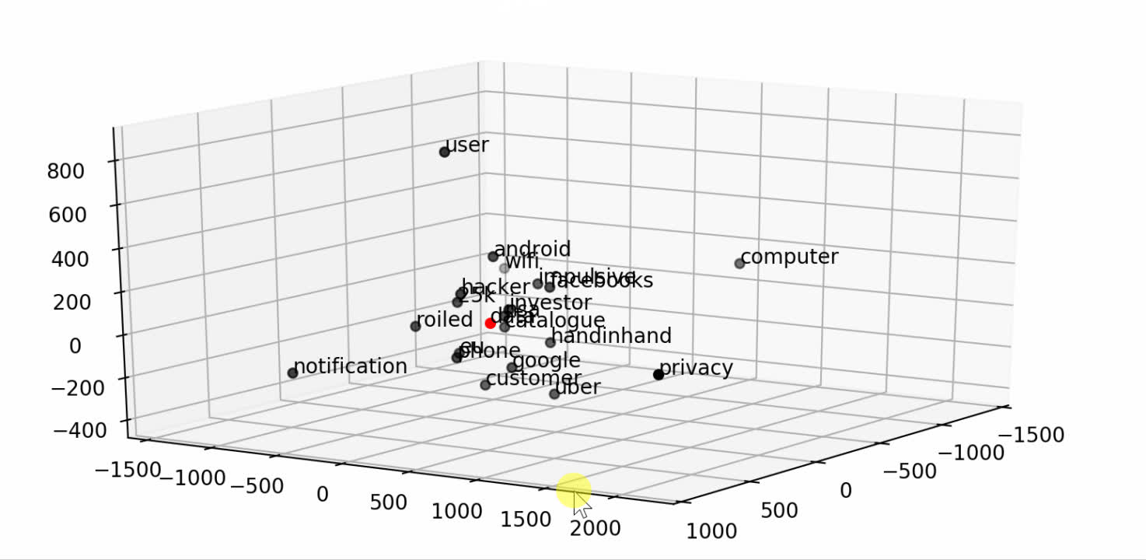

Slide 43
LSTM Layer
- Purpose: Capture sequential patterns and dependencies within input sentences.
- Description: Converts input sequences of word indices into dense, fixed-size representations by processing the sequences sequentially.
Notes:
These methods offer different approaches to measuring sentence similarity, and their suitability depends on the specific task requirements, dataset characteristics, and computational constraints. Ongoing research continues to explore novel techniques for improving the accuracy and efficiency of sentence similarity measurement in NLP applications.

Slide 44
WHAT’S THE Hyperparameter Tuning
OF the LSTM Layer?

Slide 45
LSTM units: Specifies the dimensionality of the output space of the LSTM layer.

Slide 46
Euclidean Distance Calculation
- Purpose: Quantify the difference between representations of input sentences.
- Description: Calculates the Euclidean distance between fixed-size representations generated by the LSTM layers.
Notes:
These methods offer different approaches to measuring sentence similarity, and their suitability depends on the specific task requirements, dataset characteristics, and computational constraints. Ongoing research continues to explore novel techniques for improving the accuracy and efficiency of sentence similarity measurement in NLP applications.

Slide 47
Dense Layer with Sigmoid ActivatioN
- Purpose: Predict similarity score between input sentences.
- Description: Applies a sigmoid activation function to the Euclidean distance to constrain the output to the range [0, 1], representing the predicted similarity score.
Notes:
Preprocessing involves transforming raw text data into a format suitable for model input.

Slide 48
WHAT’S THE Hyperparameter Tuning
OF THE DENSE LAYER?

Slide 49
The dense layer has 1 neuron and utilizes the sigmoid activation function.

Slide 50
Training Process
- Purpose: Optimize model parameters to accurately predict similarity scores.
- Description: Trains the model using pairs of sentences and their similarity scores. Minimizes binary cross-entropy loss with the Adam optimizer (learning rate: 0.001).
Notes:
Preprocessing involves transforming raw text data into a format suitable for model input.

Slide 51
Inference Process
- Purpose: Predict similarity score between two input sentences.
- Description: Preprocesses input sentences, converts them into sequences of word indices, and predicts similarity score using trained model parameters.
Notes:
Preprocessing involves transforming raw text data into a format suitable for model input.

Slide 52
HOW’S THE MODEL TRAINED?

Slide 53
-LOSS FUNCTION AND OPTIMISER
-BATCH SIZE
-NUMBER OF EPOCHS
TRAINING DATA

Slide 54
LOSS function and OPTIMIZER
- Utilize binary cross-entropy loss and Adam optimizer.
- Binary cross-entropy measures dissimilarity between predicted and actual similarity scores.
- Adam optimizer offers adaptive learning rate and momentum.
Notes:
Preprocessing involves transforming raw text data into a format suitable for model input.

Slide 55
Training Process
- Determine batch size to balance convergence speed and memory constraints.
- Larger batch sizes accelerate convergence but may require more memory.
- Experiment with different batch sizes to find an optimal balance.
Notes:
Preprocessing involves transforming raw text data into a format suitable for model input.

Slide 56
Training Process
- Define epochs for complete passes through the training dataset.
- Optimal number of epochs balances underfitting and overfitting.
- Employ techniques like early stopping to prevent overfitting.
Notes:
Preprocessing involves transforming raw text data into a format suitable for model input.

Slide 57
Training Process
- Curate diverse dataset of sentence pairs with similarity scores.
- Ensure dataset encompasses linguistic variations and semantic similarities.
- Split dataset into training, validation, and test sets for evaluation.
Notes:
Preprocessing involves transforming raw text data into a format suitable for model input.

Slide 58
Evaluation OF THE TWO MODELS

Slide 59
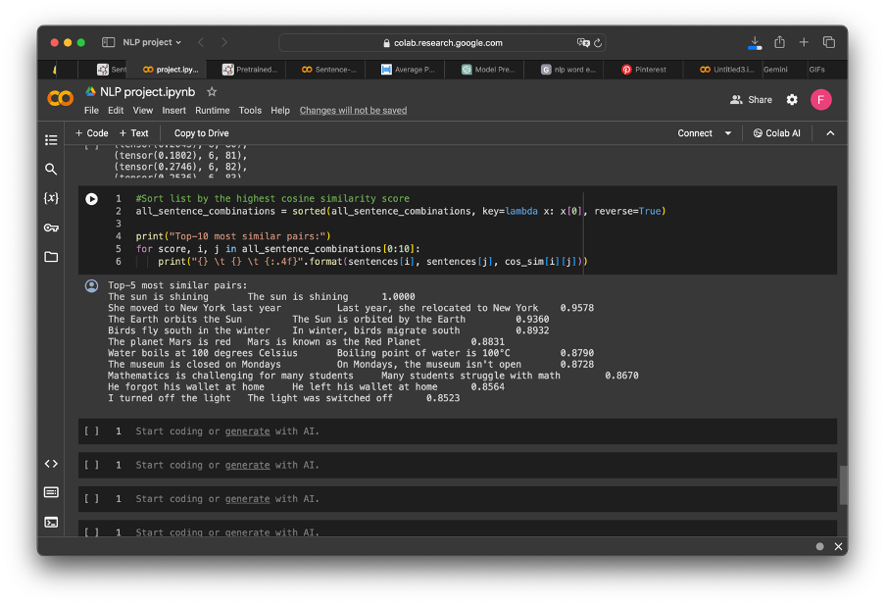
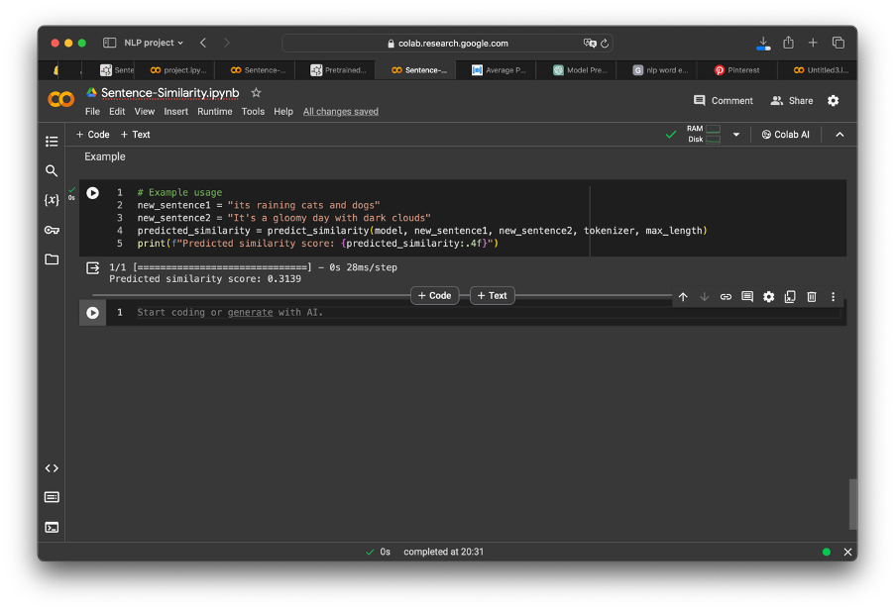

Slide 60
The first model demonstrated significantly superior performance compared to the second model. Its robust architecture and effective training strategy led to more accurate predictions and better capture of semantic relationships between sentences, highlighting its superiority in sentence similarity prediction tasks.

Slide 61
Thank you

